Slide 1
Next Steps to Counter
Fraud and Deepfakes
Digital Thinkers Forum #28
2024-10-09
Dr. Joshua I. James
Joshua.James@UN.Org

Slide 3
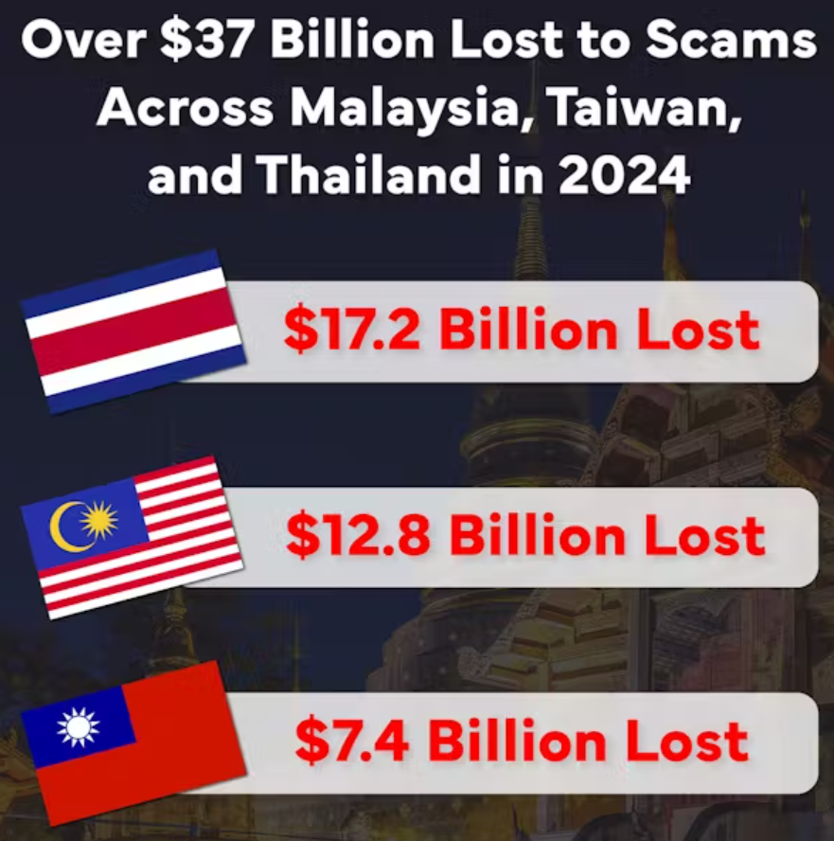
67% of Thai victims not reporting scams to authorities
~106,027 Cases
THB 577,490,754,417
https://www.gasa.org/research

Slide 4
How could this happen?

Slide 5
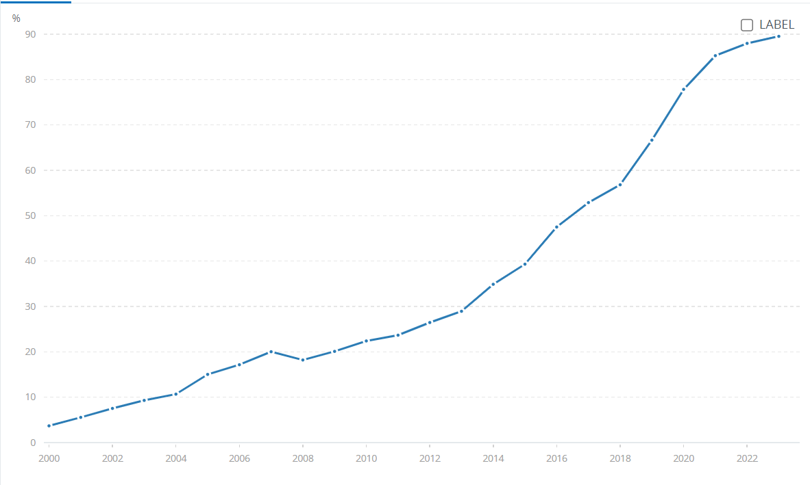
Quick growth = focus on infrastructure
Security is an afterthought
Thailand Population % Internet Access Since 2000
https://data.worldbank.org/indicator/IT.NET.USER.ZS?end=2023&locations=TH&start=2000&view=chart

Slide 6
https://www.reuters.com/world/asia-pacific/thai-household-debt-record-high-amid-sluggish-economy-survey-shows-2024-09-10/

Slide 7
Perfect Storm
More people online (scale + new tech users)
Instant National Money Transfer Services
Near Instant International Money Transfer Services
Cryptocurrencies
Old/Strict Banking Privacy Law
High Debt -> Desperate for quick cash
Tazama.org

Slide 8
Main Problems

Slide 9
Scale and Reach
One criminal can access hundreds of thousands of victims
Telecom Companies / Social Media
Automation, AI Chatbots, Deepfakes
Tazama.org

Slide 10
Old Systems / No Controls
Current prevention infrastructure/law is not designed to scale
Complicated, slow procedure
Police don’t have enough people for 30,000 fraud cases a month
(many other types of crime)

Slide 11
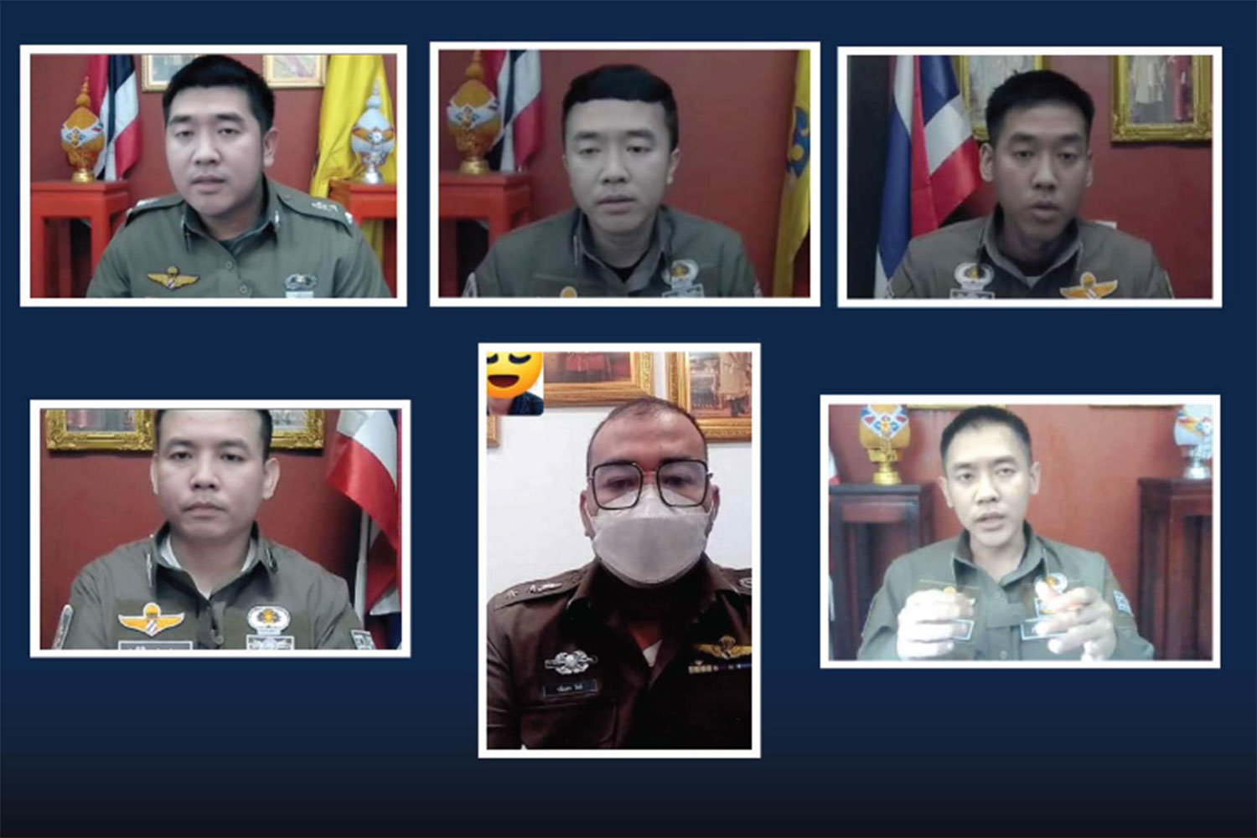
Unclear / Inaccessible Information
How do I know which page / app / Line account is correct?
https://www.bangkokpost.com/thailand/general/2830228/exposed-thai-call-scammers-in-police-uniforms

Slide 12
Corruption and Collusion
Concerted Political / International Pressure
Financial Action Task Force (FATF)

Slide 13
International Cooperation is hard
Governments -> National
Criminals -> International
Investigations difficult, sharing information difficult
(politics not technology)
Tazama.org

Slide 14
What to do?
Next Steps!

Slide 15
HUGE improvement in two years!
Royal Thai Police CIB / CCIB
National Broadcasting and Telecoms Commission
Ministry of Digital Economy and Society
BoT / Thai Bankers’ Association
National Cyber Security Agency
Many more…

Slide 16
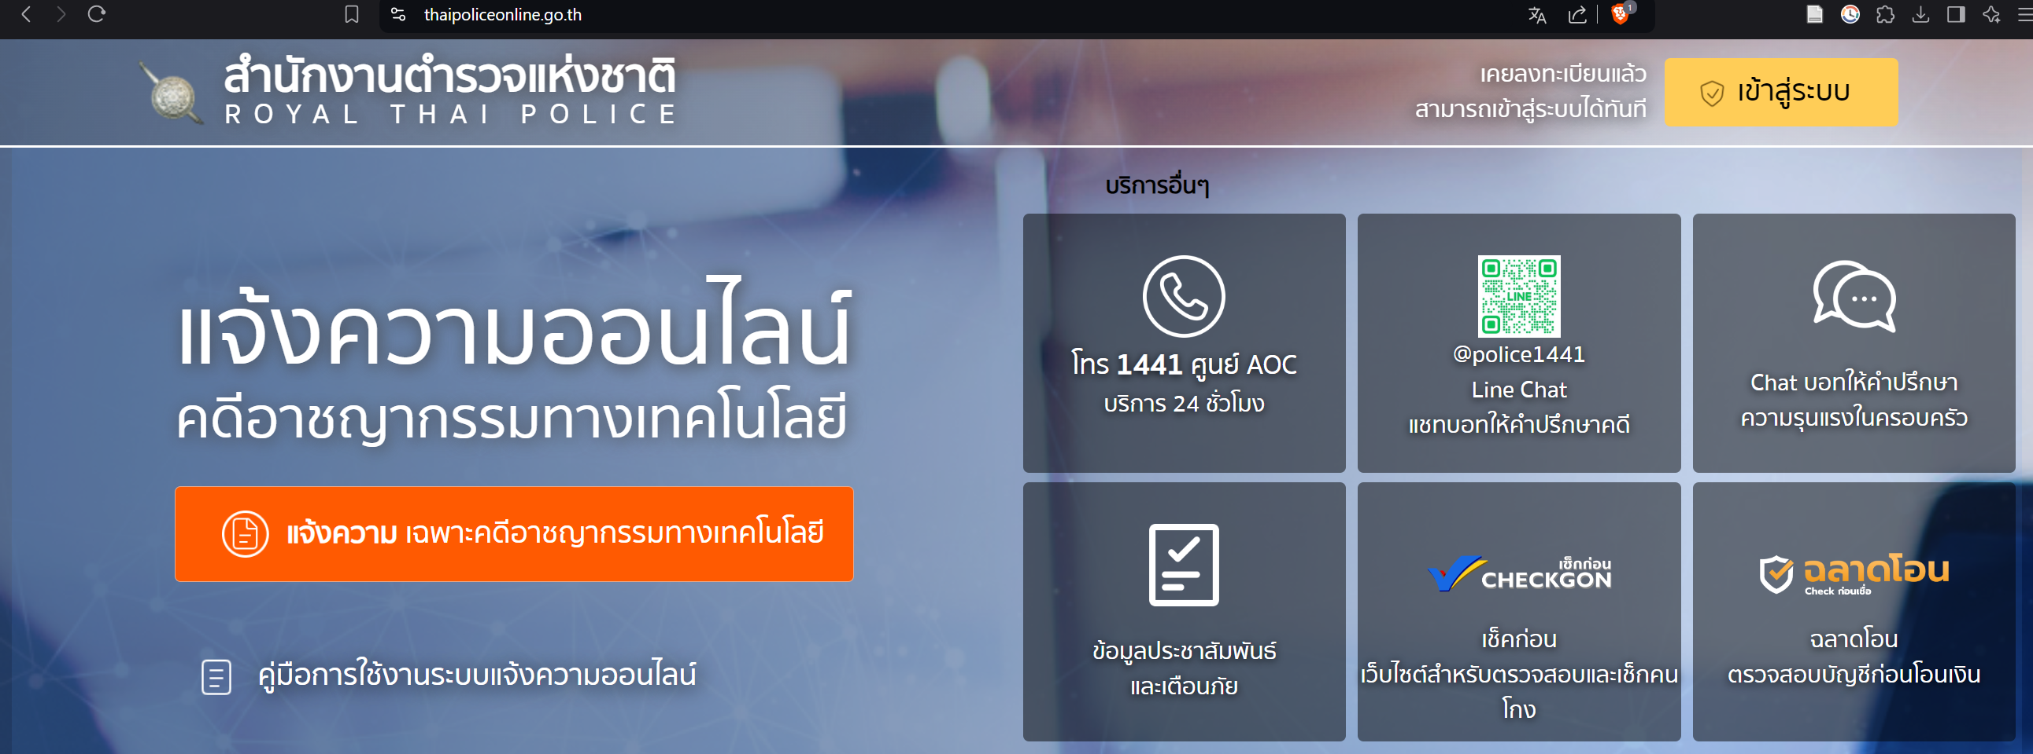
1441
Make the process easier for victims to report quickly (one report)
https://thaipoliceonline.go.th

Slide 17
Every transaction processor must implement a standard fraud/ML detection system
Allow Law Enforcement to flag suspected fraudulent accounts in real time
Banks/LEA share flagged accounts internationally in real time
India is a good case study in real-time banking intelligence sharing at scale
Tazama.org

Slide 18
Service providers need to lock down their platforms
Act more quickly on fake groups/accounts impersonating
Global Anti-Scam Alliance Signal Exchange
South Korea Police Fraud / Scam DB
Deep Fakes (limited) https://StopNCII.org
https://www.gasa.org/global-signal-exchange

Slide 19
More investment for staffing and training
Bank security teams (CERTS)
Financial Intelligence Units
Law Enforcement (prosecutors/judges)
University programs/clubs -> More local experts

Slide 20
Governments and companies take a hard stance against corruption

Slide 21
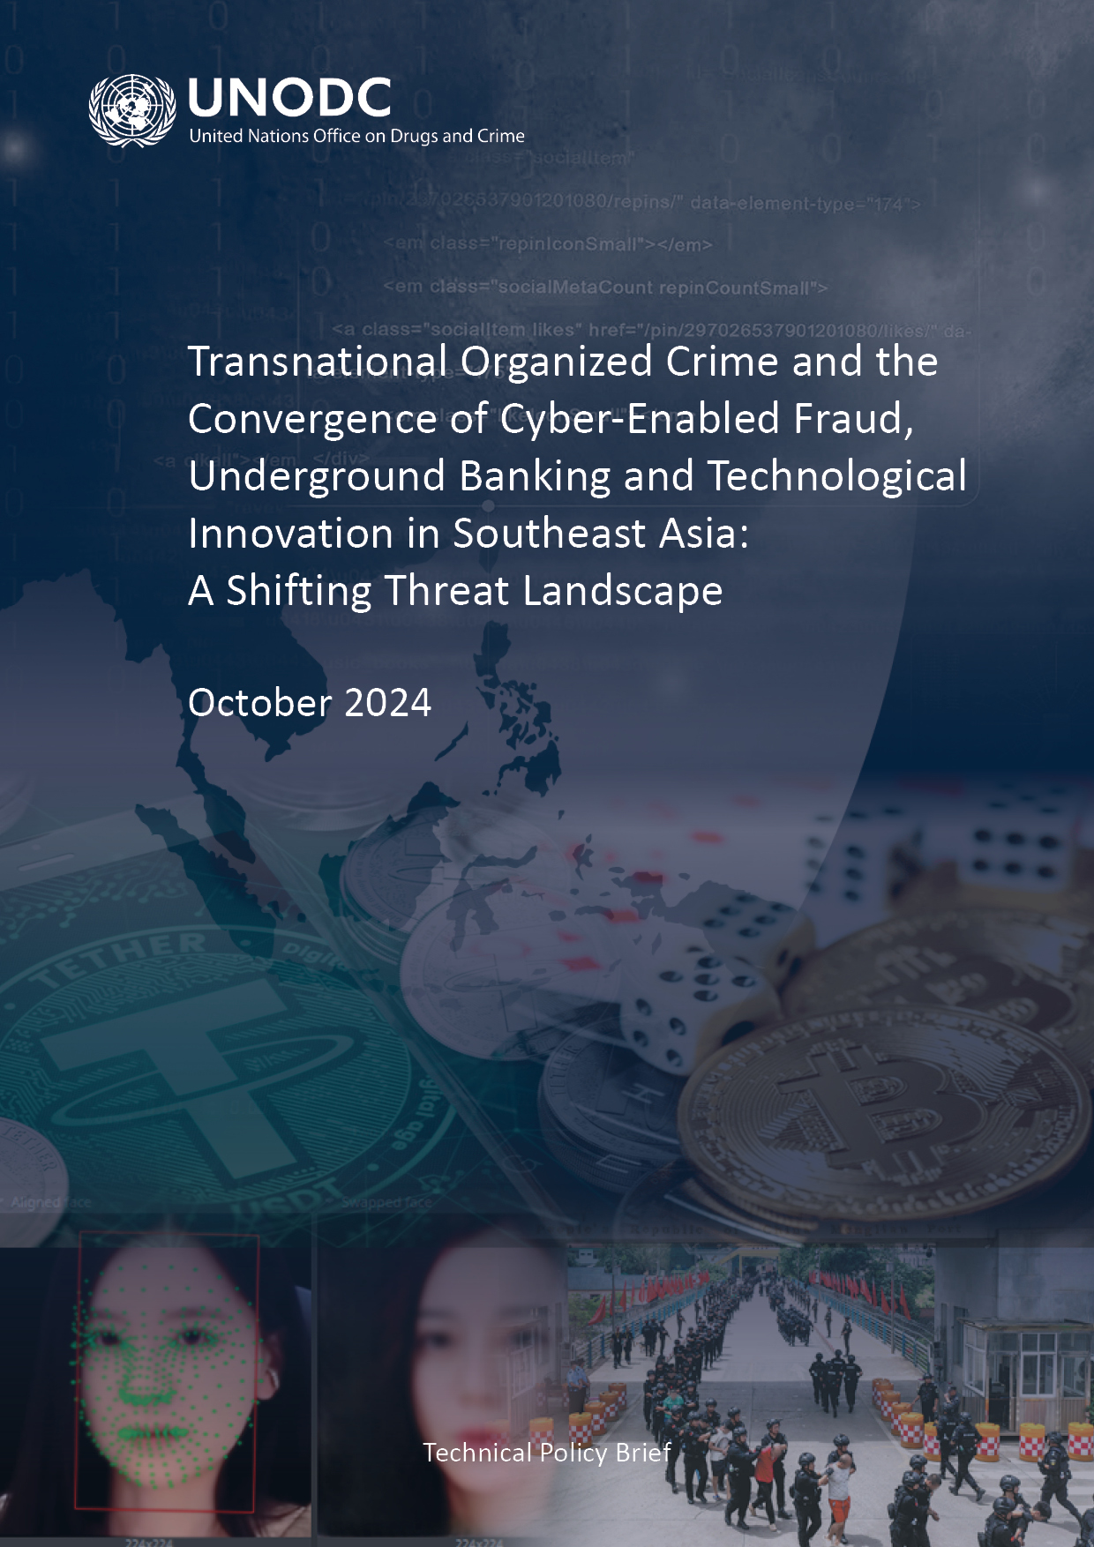
Use and support the United Nations Office on Drugs and Crime
Global Programme on Cybercrime
Legislative support
Technical support / training
Curricula development
Research
UN Convention on Cybercrime
https://www.investopedia.com/terms/s/smart-contracts. https://www.unodc.org/roseap/uploads/documents/Publications/2024/TOC_Convergence_Report_2024.pdf

Slide 22
Thai Police will never:
Contact people via Line or video to question them or notify of charges;
Ask people to transfer money or assets for examination to prove their innocence;
Send official documents, including summonses or arrest warrants via Line
If you are a victim of fraud/scams contact 1441

Slide 23
Thank you
https://www.unodc.org/roseap
https://pixelplex.io/blog/smart-contract-vulnerabilities/

